Slide 1
Ontology in IoT Security

Slide 2
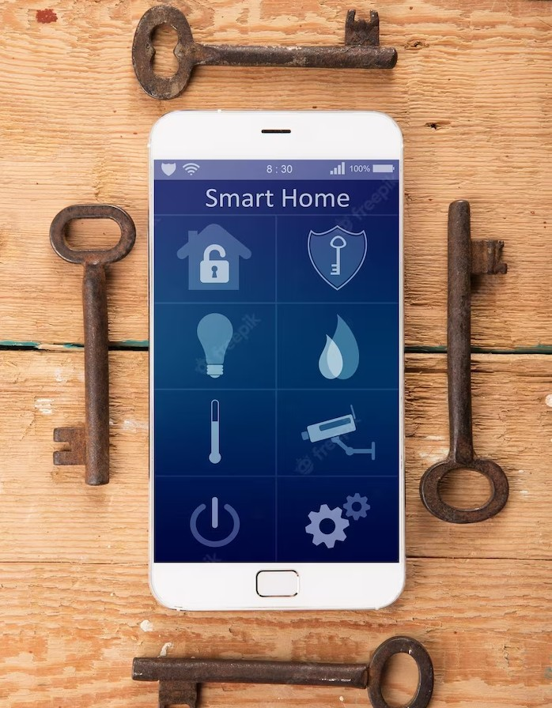
Introduction * In this presentation, we will explore the power of Ontology in safeguarding Internet of Things (IoT) devices. * IoT devices are vulnerable to security threats, and it is crucial to enhance their security measures. * Ontology provides a solution by enabling secure and trusted interactions between IoT devices, ensuring data integrity and privacy.

Slide 3

Ontology is a branch of philosophy that deals with the nature of existence and reality. In the context of technology, Ontology refers to the formal representation of knowledge and the relationships between concepts. It provides a framework for organizing and structuring information, making it easier to analyze and process.

Slide 4
Role of Ontology in IoT Security
Ontology serves a crucial role in ensuring the security of the Internet of Things (IoT).
It provides a foundation for identifying potential vulnerabilities, implementing access controls, and enforcing secure communication protocols.
By leveraging ontology, we can establish standardized security policies, detect and respond to threats, and safeguard the integrity and confidentiality of IoT data.

Slide 5

IoT Security Challenges
The rapid growth of IoT devices has led to an increase in security challenges.
IoT devices are often vulnerable to attacks such as malware, data breaches, and unauthorized access.
These security threats can have serious consequences, including the compromise of personal data and the disruption of critical systems.
It is essential to address these challenges to ensure the safe and secure deployment of IoT devices.

Slide 6

Ontology plays a crucial role in enhancing IoT security. By utilizing Ontology, we can establish a secure and trusted environment for IoT devices. Ontology enables the authentication and authorization of devices, ensuring that only authorized devices can access the network. It also facilitates secure data transfer and communication, protecting sensitive information from unauthorized access. With the power of Ontology, we can safeguard IoT devices and mitigate security risks.

Slide 7

Real-World Applications * The application of Ontology in IoT security is not just theoretical. It has real-world implications and practical applications. * For example, in smart homes, Ontology can ensure secure interactions between devices such as smart locks, cameras, and sensors. * In industrial settings, Ontology can enable secure communication between IoT devices, preventing unauthorized access and potential disruptions.

Slide 8
Thank You

